Slide 1
Teaching Basic Facts: Addition and Subtraction
Week 10, Monday
Readings: Van de Walle et al., Ch. 9 (1st half)
Notes:
Welcome students and set the stage for today's session. This class brings together understanding of how students develop fact fluency and how number talks support this development. Today students will:
• Participate in a number talk as learners (experiencing the routine firsthand)
• Learn features of fact fluency and options for teaching it
• Watch and analyze teacher moves during a number talk video
• Practice facilitating a subtraction number talk themselves
Timing: Full 50-minute session with activities embedded throughout.

Slide 2
Agenda
Do a Number Talk
Fact Fluency -- Addition edition
4 Parts of Fact Fluency
Developmental phases of Fact Fluency (a trajectory)
Teaching basic facts
Assessing basic facts
Watch a Number Talk
Notes:
Review today's agenda to orient students to the flow.
Part 1 (First 15 min): Lead the class through the definitions and standards connection for fact fluency. Emphasize: knowing facts ≠ memorizing facts; fluency comes from strategy development.
Part 2 (Next 30 min): Model a number talk using a 7-dot pattern. Review components of a number talk. Show the 8+6 video twice: first viewing focuses on student strategies; second viewing focuses on teacher moves.
Part 3 (Next 20 min): Students work in small groups to model a subtraction number talk together.
Part 4 (Final 5 min): Brief discussion on assessing basic facts.
Emphasize throughout: number talks are quick, daily routines that build both number sense AND fact fluency.

Slide 3
What is a Number Talk?
A simple teaching routine where a teacher gives students a grade appropriate computation task and asks them to mentally figure out
Takes about 10 minutes, can happen daily, works on number sense and computation.
Students are given a few minutes to determine an answer to the problem(s) using a strategy.
Students share strategies, teacher shows student strategy uses a representation, and/or records an equation for student reasoning.
Students use hand signals to participate.

Slide 4

Let’s Try a Number Talk as a Class
Notes:
Define a number talk as a structured but open-ended routine. Key components to highlight:
• Computation task given mentally (no pencil/paper for students initially)
• Teacher does NOT model strategies first—students discover them
• Takes 5-10 minutes (can be done daily)
• Focuses on number sense, flexible computation, and building fluency through strategy
• Builds a classroom culture of mathematical thinking
Emphasize: A number talk is NOT a timed drill or test. It's a collaborative thinking routine.
Main teaching move at this stage: Allow 2-3 minutes of quiet thinking time before sharing. This is critical—don't rush students.

Slide 5
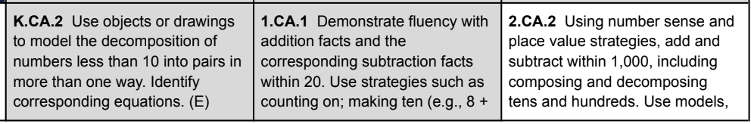
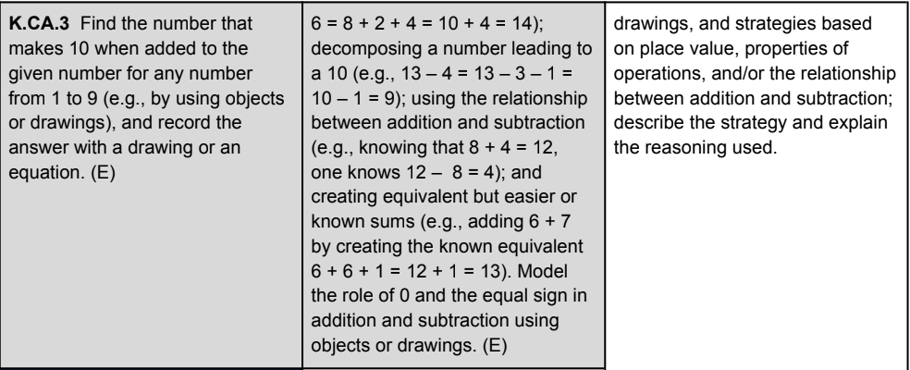
Where is basic fact fluency in the standards?
Mastery
Notes:
You will lead a number talk with the 7-dot flash card right now. Use this as a live demonstration so students can experience it as learners first.
PROCEDURE:
1. Show the 7-dot pattern on the card/screen for 3-5 seconds, then cover it.
2. Ask: "How many did you see? Tell me in a way that shows your thinking." Allow 2-3 minutes silent thinking time—students can jot thoughts/quick sketches.
3. Go around and collect 3-4 different answers/strategies (don't correct yet). Represent each strategy visually on the board:
- "I counted by ones: 1, 2, 3, 4, 5, 6, 7"
- "I saw two groups: 3 and 4"
- "I saw two groups: 5 and 2"
- "I made a pattern/visual grouping"
4. Affirm all strategies. Say things like: "I like how you used groups," "That's a fast way to figure it out."
5. Ask: "Which strategy was helpful to you?" Let students connect strategies.
Key teaching moves: Wait time (silence is OK), revoicing ("So you saw 5 and 2, and that made 7?"), connecting ("Anyone use a similar idea?")
Debrief briefly: "This is a number talk. Now we'll watch how this looks with addition facts and see what the teacher does to help students think."

Slide 6
What does “fact fluency” mean? (VdW’s 4 parts of fact fluency)
p. 11 Unit 3 packet
Notes:
Connect fact fluency to standards. Read the standard on the slide (likely CCSS or Indiana standard about fluency with addition/subtraction within 10, 20, etc. depending on grade).
Key point to emphasize: Standards don't say "memorize by drill." They say "fluent"—which means flexible, efficient, and strategic. This distinction is critical for teacher candidates to understand.
Ask students: "What does 'fluent' mean in music? (smooth, flowing, knows the piece well enough to play expressively) Math fluency is similar—it's not about speed or memorization, it's about knowing multiple ways to solve and choosing an efficient strategy."
Connect this to the lesson ahead: We're going to see HOW students develop this fluency—through building strategies, NOT through timed drills.

Slide 7
What does “fact fluency” mean? (VdW’s 4 parts of fact fluency)
Yes!
Efficiency: Can student recognize when one strategy is more efficient than another?
How long does it take them to pick a strategy?
Note: Efficiency varies with different facts. (Think about your own FF.)
Accuracy: Is the student using strategies that get correct answers?
Flexibility: Can think about a problem in more than one way when prompted
Appropriate: Can choose an appropriate strategy to solve for an unknown fact … using known facts
Yes!
And…
Notes:
Introduce Van de Walle's four components of fact fluency (this is foundational to the lesson). Read each component as you go through them.
Make sure to emphasize: These are sequential. Students must first understand the concept (e.g., "what is 7+3?"), then develop strategies (e.g., "I can make a ten"), then build efficiency, and finally they might memorize as a result of using the facts repeatedly.
This is VERY different from traditional drill-and-practice. The memorization happens at the end of the development, not the beginning.

Slide 8
What is automaticity?
Automaticity is different from fluency
Automaticity means quick recall of basic facts
Fact fluency is the road (or work) that leads to automaticity
Notes:
Continue the explanation of fact fluency components if there are multiple parts shown. Ensure students understand that fluency development is:
• Conceptual first (understanding WHY 7+3=10)
• Strategic next (knowing multiple ways to get the answer)
• Efficient (recognizing which strategy is fastest for each problem)
• Automatic (after much use, the answer becomes automatic—this is NOT drilled in)
Emphasize the phrase: "Memorization should be a consequence of strategy use, not a goal in itself."
Ask: "Why is this important for YOUR classroom? Because if you only drill facts, students who haven't developed strategies yet will feel lost or anxious."

Slide 9
Trajectory for kids to DEVELOP fact fluency
Notes:
Important distinction: Automaticity ≠ Fluency.
Automaticity = quick, automatic recall (like "7+3" instantly = "10")
Fluency = knowing multiple strategies, choosing an efficient one, and being flexible
Many traditional curricula conflate these. The standard asks for FLUENCY, not automaticity.
Key teaching move: Help students see that automaticity might happen naturally once fluency is developed and facts are used repeatedly. But it's not the goal—fluency is.
Example: "A student who is fluent with 7+3 might say '7 and 3 makes 10, so it's 10' OR 'I know 7+2 is 9, so 7+3 is one more, so 10.' Either way is fluent. Eventually they'll just say '10' automatically. But we're building fluency first."

Slide 10
Trajectory for kids to DEVELOP fact fluency
Phase 1: Counting Strategies
Phase 2: Reasoning Strategies
Phase 3: Mastery! .
Phase 1:
Counting all, counting on
Students may use fingers or blocks or simply count in their head
Phase 2:
Doubling, near doubles,
Base 10s: combinations of 10, making 10, pretend-a-10
5 as anchor (like using “6” in N101)
Use strategies to solve problems, not just to compute
Phase 3:
Producing answers efficiently, accurately, using appropriate strategies, and flexibly
Notes:
Explain the developmental phases of fact learning. This is crucial context for why number talks matter.
Phase 1 (Counting strategies): Students still need to count. They use fingers, objects, drawings. They're building foundational understanding. Examples: 8+2 by counting on from 8; 6+4 by counting all. This is developmentally appropriate and necessary.
Help students see: "Phase 1 is not 'broken.' It's the foundation. We support it, then gradually move students toward more efficient strategies."
Question for the group: "Have you seen a first grader use fingers? Is that bad? (No!) It shows they understand the quantity and are working toward efficiency."

Slide 11
Approaches to TEACHING basic facts
Phase 1: Counting Strategies
Phase 2: Reasoning Strategies
Phase 3: Mastery! .
Memorization:
Often bypasses phase 2 in developmental phases.
Students are often inefficient, not flexible, or inaccurate (from guessing).
Explicit Strategy Instruction:
You teach a strategy. Then students explore.
Strategies are ways to think about problems, not tricks to be memorized
Guided Invention:
More open-ended path to learning strategies.
Students introduce strategies, and multiple strategies may be discussed for a particular problem.
Notes:
Phase 2 (Strategy-based): Students are building efficient strategies WITHOUT counting all. Key strategies include:
• Doubles (6+6=12, then 6+7 is one more)
• Near doubles (7+8 = 7+7+1 = 14+1 = 15)
• Make a ten (7+4: make 10 by taking 3 from the 4, so 10+1=11)
• Decomposing (8+6: 8+2+4 = 10+4 = 14)
• Building on known facts (8+5: "I know 8+4=12, so 8+5 is one more, so 13")
These are the strategies you'll see in the video. Students at this phase are efficient and flexible.
Say: "When we do number talks, we're helping students move through this phase by showing them that there are MANY ways to think about a problem. Some kids will use doubles, some will make a ten—both are smart!"

Slide 12
Teaching facts effectively
Phase 1: Counting Strategies
Phase 3: Mastery
Phase 2: Reasoning Strategies
Use story problems (or contextualized problems).
Pose a daily story problem to help students become better problem solvers as they work on basic facts.
Use Quick Images/Looks (e.g., showing a ten frame)
Help students move beyond simply counting to solve problems.
Using Number Talks to explicitly teach reasoning strategies or to using guided re-invention
Use known facts and relationships to derive unknown facts.
Notes:
Critique memorization-focused approaches while being respectful. Many teachers grew up with flashcard drills and may be skeptical of other approaches.
Key points:
• Traditional memorization (flashcard drills, timed tests) often skips the developmental phases shown in Slide 9-10
• Students who haven't developed strategies yet often fall behind and become math-anxious
• Memorization can work for some kids but doesn't help them develop flexible thinking
• This approach has NOT been research-supported for the past 20+ years
Ask: "Has anyone had the experience of being drilled on facts as a kid? How did that feel? Did it help you understand math?" (Many will have negative associations. Validate those.)
Position this positively: "There's a better way that actually BUILDS understanding AND gets students to fluency faster."

Slide 13
Addition Strategies – Share your knowledge
Each teacher at your table: Claim a strategy
Become an expert on your strategy. (Use the page numbers on your paper.)
Go around the table describing strategies to the group
We’ll watch the video together
Notes:
Present research-informed approaches. These are the alternatives to pure memorization.
Best practices include:
1. Use story/context problems: "Maria has 7 apples. Her friend gives her 4 more. How many does she have?" This gives meaning to the operation.
2. Use manipulatives/visual models: Ten frames, number lines, part-part-whole models
3. Play strategy games: Subitizing games, "Make 10" games
4. Use number talks (as you're doing today!)
5. Build fact families: 7+3=10, 3+7=10, 10-7=3, 10-3=7 (all related)
Emphasize: "These methods build understanding AND eventually lead to memorization. It's not either/or—it's building facts on a foundation."
Timeline: By mid-grade 1 (with daily support), most kids should be fluent with +/- facts within 5. By end of grade 1, within 10. By grade 2, within 20.

Slide 14
Addition Strategies
One more than, two more than: 5 + 1 = 6 or 7 + 2 = 9
Adding zero: 5 + 0 = 5
Double, near doubles: 8 + 8 = 16 and 8 + 7 = 15
Combinations of 10: 6 + 4 = 10
Making 10: 8 + 7 = 15 because 8 + 2 =10 and 10 + 5 =15
Pretend-a-10 (Use 10): To find 9 + 6, think about 10 + 6 = 16. So, 9 + 6 = 15
Using 5 as Anchor: 7 + 6 = 13 because 5 + 5 = 10 and 2 + 1 = 3
How do these compare with N101 strategies?
Notes:
This is a transition slide to prepare for the video. Tell students: "In the video you're about to watch, you'll see a teacher do a number talk with 8+6. Watch for the different strategies the kids use. We'll pause and talk about them."
Frame the video viewing: "First viewing: Notice all the different ways kids solved 8+6. How many different strategies can you count? Second viewing: Notice what the TEACHER does. What moves does she make? How does she help kids think?"
This frames the observation task and keeps students focused during the video.

Slide 15
Subtraction Strategies
Think addition:
15 – 8 = ? “How far apart are 15 and 8?”
Down under 10:
15 – 8 = ? “How many do I take away to get to 10? How many more do I need to take away? So 15 – 8 would be…?”
Take from 10:
15 – 8 = ? “15 is 10 + 5. I know that 10 – 8 is 2. So 15 – 8 would be ...” (Separate / take-away subtraction)
15 – 8 = ? “15 – 5 is 10. And if I subtract another 2, I get to 8. So 15 – 8 is …” (Comparison / difference subtraction)
How do these compare with N101 strategies?
Notes:
After the video (or during pauses), refer to this slide to name the strategies students used.
Reference the video students:
• Lorena: Uses doubles. 7+7=14, and 8+6 is one more each, so still 14. (Or similar doubling logic)
• Kim: Decomposes 8+2+4. Breaks 6 into 2 and 4, adds 2 to make 10, then adds 4.
• Lane: Make-ten strategy. Takes from one number to make 10 with the other, then adds remainder.
• Patrick/Selena: Building on known facts. "I know 8+5=13, so 8+6=14."
• Greta: Near doubles. 6+6=12, so 8+6 must be 2 more, = 14.
Highlight: "Each strategy is VALID. No one is 'better'—they're just different. In a real classroom, you'd want kids to see ALL these options and eventually choose which strategy they like best."
Key teaching move: "The teacher RECORDS each strategy visually. She doesn't say 'yes, that's right' and move on. She shows HOW each kid thought. Why? Because other kids see themselves in those strategies and can try them."

Slide 16
Assessing basic facts
Timed tests:
Aren’t a bad thing IF a teacher wants to gauge automaticity, BUT…
Timed tests do NOT help students LEARN basic facts. Fact fluency through number talks does.
Other ways to assess AND LEARN basic facts:
Games
Group practice
Notes:
Subtraction is often taught as a separate operation, but it builds on addition understanding. Key strategies:
Think-addition: 15-8="How far apart are 15 and 8?" This is actually MORE efficient than "count back." It connects to fact families.
Count up: From 8, count up to 15. 8...9, 10 (2), 11 (3), 12 (4), 13 (5), 14 (6), 15 (7). So 7.
Count back: From 15, count back 8. This is slower but developmentally appropriate first.
Decompose/Break apart: 15-8 = 15-5-3 = 10-3 = 7
Use ten frames: Show 15 in a ten frame, remove 8, count what's left.
Emphasize: "Subtraction can feel harder to kids than addition. Why? Because the structures aren't as obvious. NUMBER TALKS help kids see that subtraction is related to addition and builds flexibility."
Note: In the group activity (next), students will facilitate a SUBTRACTION number talk.

Slide 17
Until Next Time
Multiplication & Division:
Standards Reading (linked in Canvas)
VdW Reading – Back to Ch. 8 (pages/sections in Canvas)
Week 10 Check-In is open & due Fri @ 11:59pm
\?
Notes:
Wrap up the session by reviewing what was covered and connecting to next time.
Summary of today:
• Experienced a number talk firsthand (with the 7-dot pattern)
• Learned Van de Walle's definition of fact fluency (4 components)
• Watched and analyzed teacher moves in a number talk video
• Facilitated a subtraction number talk in groups
• Discussed assessment of fact fluency
Key take-away: "Fact fluency is built through strategy development, not memorization. Number talks are a powerful way to develop and share strategies. You'll use this routine in your own classroom."
Preview next class: "Next time we're learning about multiplication and division. Same principles apply—strategies and flexibility matter more than memorization. Come prepared to read the standards and articles linked on Canvas."
Send-off: "You all did great facilitating number talks today. It might feel awkward at first, but the more you do it, the more natural it becomes. Feel free to reach out if you have questions about number talks or fact fluency before next class."

